Slide 1
Data Science Bootcamp
Spring ’24
Week 1: Introduction to Python
02/27/2024

Slide 2
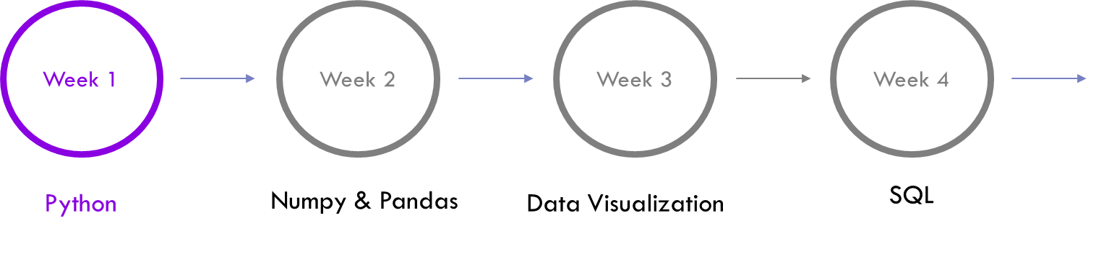
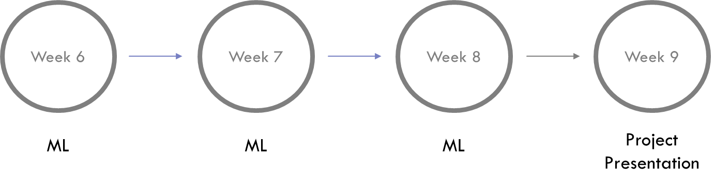

Bootcamp Timeline

Slide 3

Logistics
Join the SLACK community – Perfect place to ask your questions and discuss interesting problems and find project teammates.
Visit the GitHub page to access PPTs and Colab notebooks discussed in each section.
You can email us at datasciencebootcamp@nyu.edu

Slide 4

Agenda
Why Python ?
Datatypes
Control Statements
Loops
Functions
Scope

Slide 5


Why use Python?
EASY to read, learn and write. It is a High Level language.
Its HIGHLY PRODUCTIVE – Much more concise and requires less time, effort and lines of code to perform the same operations.
It is slow but Development Speed >> Execution Speed
Big Community – Rich set of standard libraries and frameworks for several purposes.
Fun Fact : Python is written in C

Slide 6
Q&A

